Slide 1
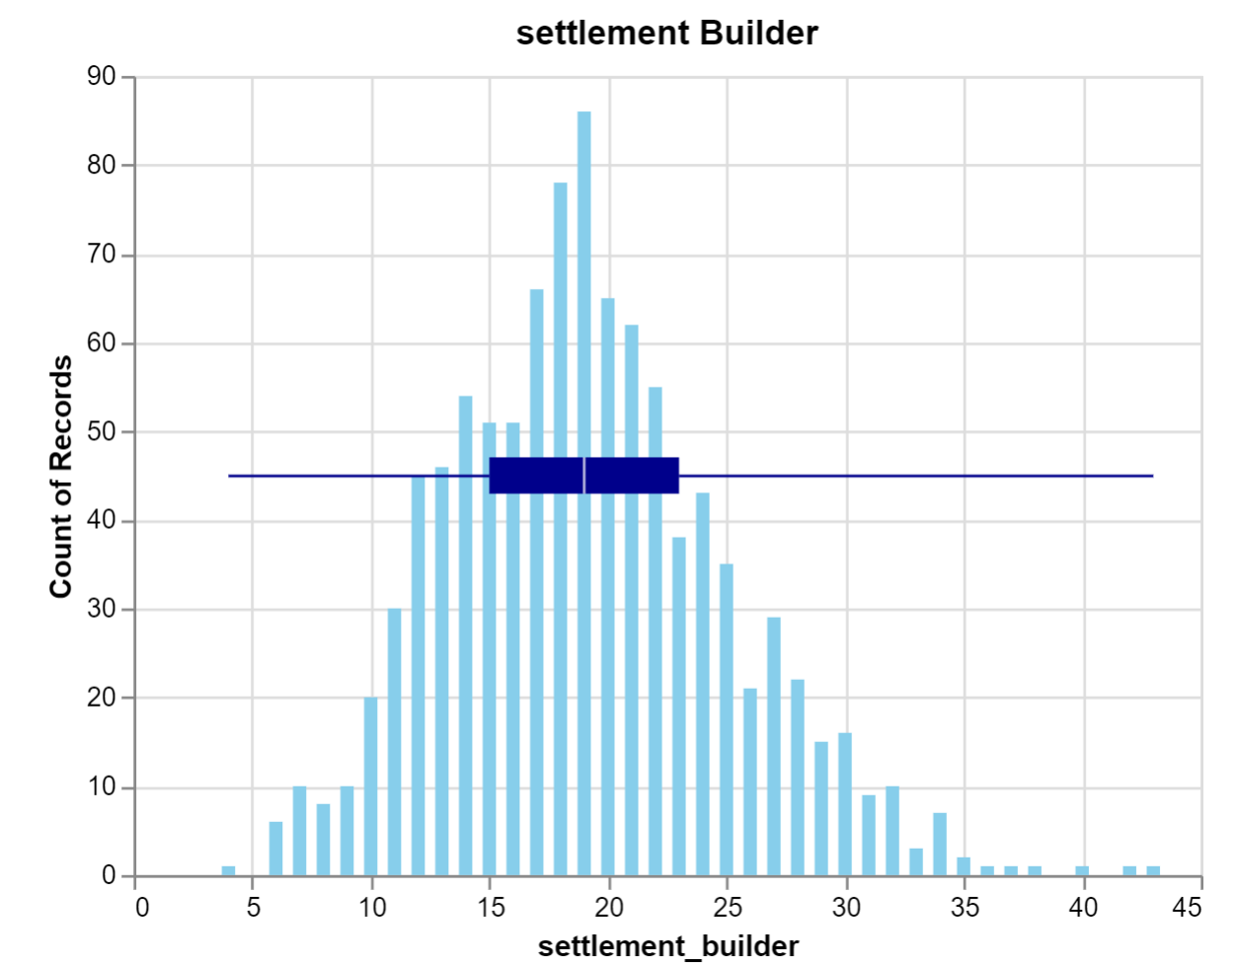
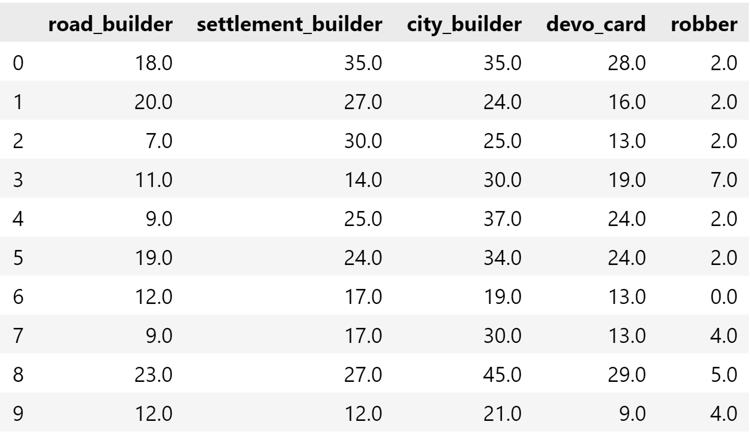
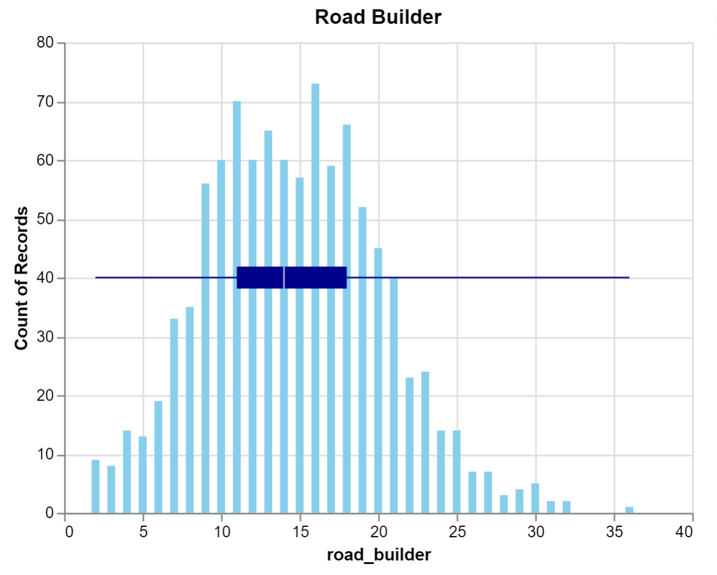
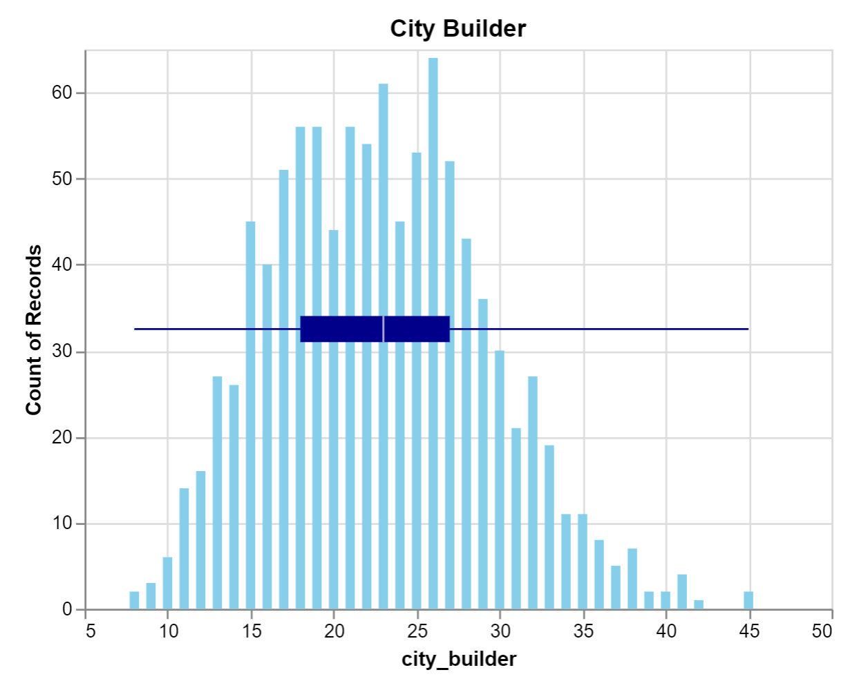
Probability: Analysis of ‘Settlers of Catan’
Through Monte Carlo Simulations
Justin Schultz
Department of Mathematics
Abstract
of these resources is what allows a player to build and expand in the game. Using dictionaries in
Python, a player could enter where their settlements are and what resources are obtained when a given number is rolled.
Gathering resources is a major part of simulating ‘Catan’. There are a few ways to get resources. Resources an be received when a player has established settlements and cities. Resources may also be obtained through maritime trade. At any point of the game, a player can trade four of the same resources from the bank. Another option of the maritime trade is to build on the coast at a trading port which has the benefit of trading resources at a discounted rate.
Utilizing a Python tool, players are able to input what resources they get (based on where their settlements and cities are) when the dice are rolled, as well as inputting their maritime trade values of each resources. The Monte Carlo simulation is now able to give an accurate prediction of how many rolls it would take for a player to build a settlement, road, city, or obtain a development card. This also simulates the role of the robber, where having more then 7 resources in your hand causes you to lose half your resource cards.
This simulation is valuable because of its ability to run thousands of dice rolls in only a few seconds. The law of large numbers provides an accurate average prediction of the number of rolls it would take for a player to build in Catan
Results
Conclusion
Settling the ever-changing island of Catan proves quite difficult when dice are used to determine every move. How much can a player do to improve their game when it is based on chance? A custom simulation was used to see how the placement of a settlement will affect a player's game.
After running the simulation 1000 times, a dataset was created with the number of rolls it takes for a player to build a settlement, road, city, or obtain a development card. The chart below displays the distribution of rolls required for a player to build a settlement.
Where should a player settle in the vast changing landscape of Catan? The simulation does not provide an exact answer. The initial goal of this simulation was to display information about where to build in order to obtain resources and build faster than opponents. The simulation currently gives a distribution of the number of rolls it would take to build a settlement, road, city, or obtain a development card.
Given more time, the simulation could be improved, especially concerning the role of the robber. The simulation did check to see if the robber would affect the player, however, the simulation did not remove half of the players cards.
Anther improvement of this simulation would be to make a prediction model of who would win a game of Catan based on their initial placement of their starting settlements.
If players build on resources that have a higher probability of being rolled (such as sixes and eights) the odds of a player building settlements and cities faster increases. However, Catan is still determined by the randomness of rolling dice. These finding suggest that you pick a strategy, stick with it, and hope that the dice land in your favor! Probability can be predicted but never controlled when playing a game with dice.
Introduction
‘Catan’: Trade, Build, Settle. These are the words you are introduced to as you embark on the board game journey of Catan. Trading, building and settling is the goal of the award-winning board game. A player needs to be able to strategically build and gain ten victory points before their opponents. Using experience and a bit of chance, a player can rule all of Catan.
A common circumstance in ‘Settlers of Catan’ is knowing the optimal place to build. How can one strategize where build, when the results of gathering resources are an outcome of random dice rolls? This is the challenge of settling Catan.
How much can strategy help a player get the upper hand? The purpose of this analysis is to understand how probability affects the game of ‘Catan’.
Monte Carlo simulations are models that help predict the probability of random events occurring like the rolling of dice. Through the use of a Monte Carlo simulation, datasets can be created to simulate how long it would take for a player to build a settlement, road, city, or collect a development card in Catan.
The first step in developing this simulation was to create a way for a player to gather the different resources. The resources in the game include lumber, grain, brick, ore, and sheep. Different combinations
The x-axis includes the number of rolls it takes for a player to build a settlement which requires a grain, a lumber, a brick and a sheep. The y-axis is the frequency in which that number occurs over the thousand different simulations. There is also a box plot in the chart that tells the minimum, first quartile, median, third quartile, and maximum number of rolls it would take for a player to build a settlement.
Other simulation outputs display the frequency of building roads, cities, gathering development cards and how often the random play of the robber affect your game
Methodology
Work Cited
Klaus Teuber. (2007). The settlers of Catan : award-winning game of discovery, settlement & trade. [Skokie, IL] :Mayfair Games,
Lee, J. S. (n.d.). Catan Monte Carlo - Justin S. Lee. Retrieved March 24, 2022, from http://www.columbia.edu/~jsl2239/catan.html
Van Rossum, G., & Drake, F. L. (2009). Python 3 Reference Manual. Scotts Valley, CA: CreateSpace.

